Slide 1


SmartPot
Tiberio Galbiati | Xiao Zifan | Jussi Pavainen | Tapio Immonen

Slide 2
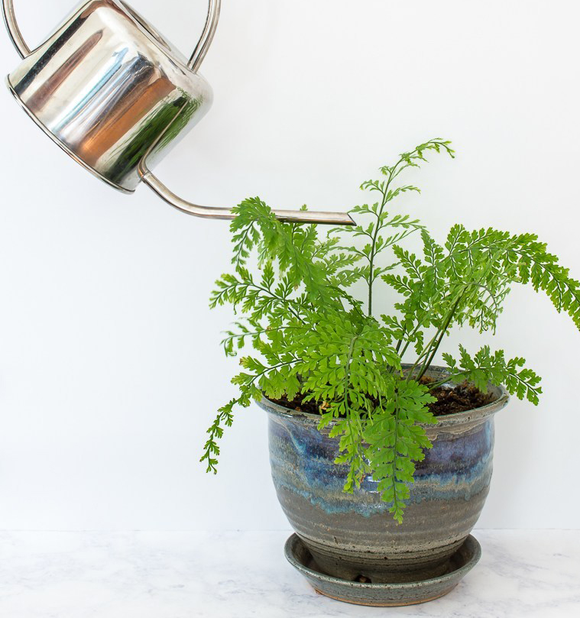

Never water
your flower
again by yourself!

Slide 3
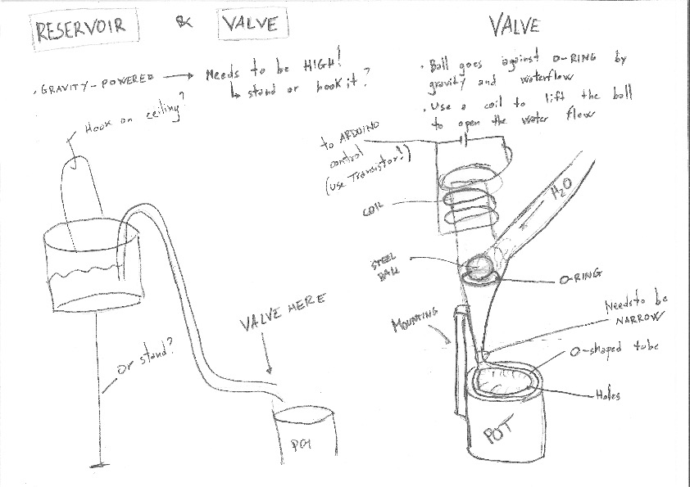
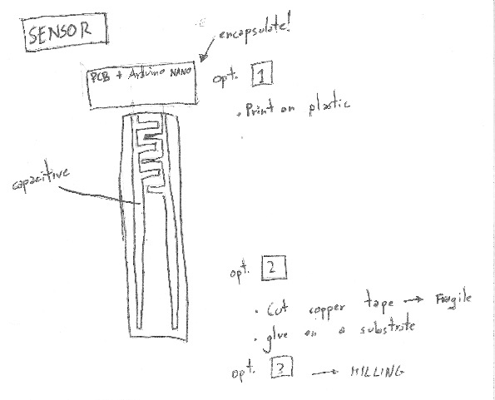
From sketches

Slide 4
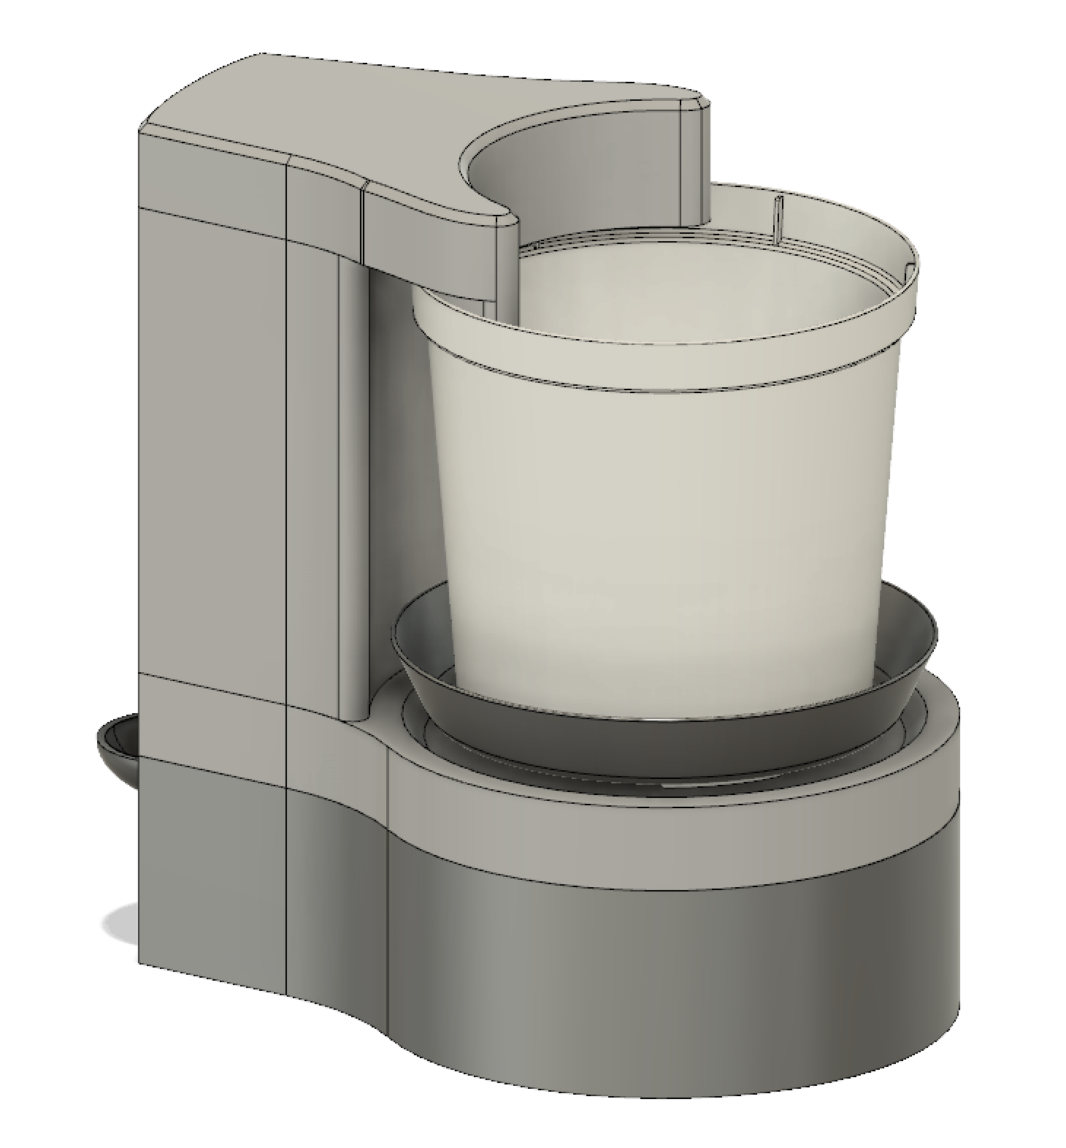

Better sketches

Slide 5
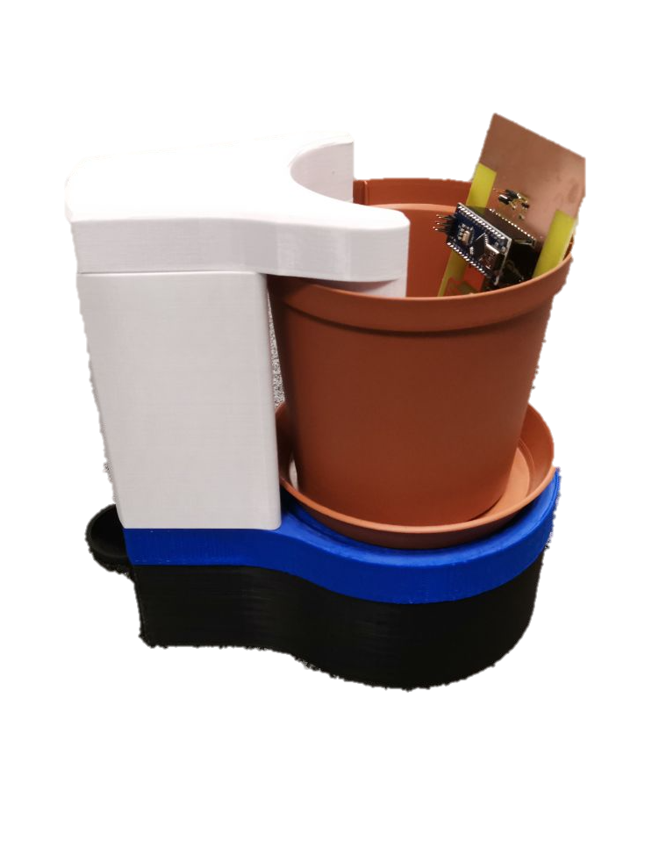
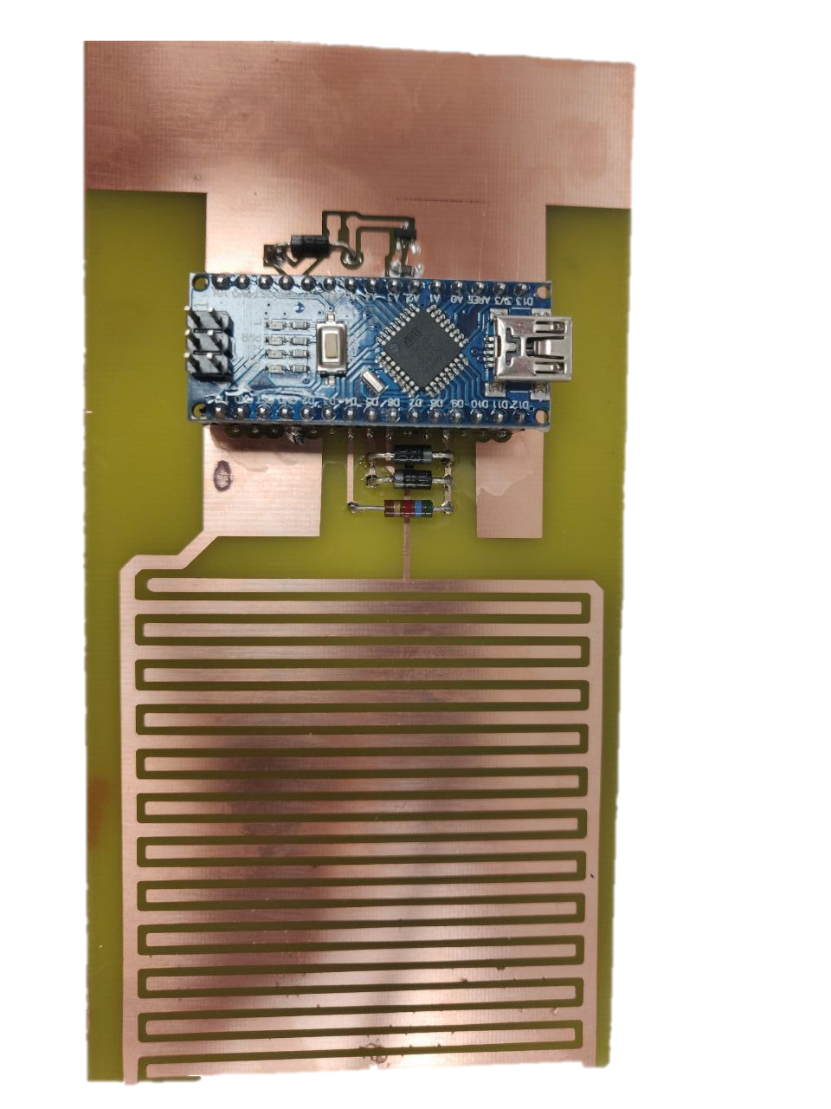
Prototype

Slide 6
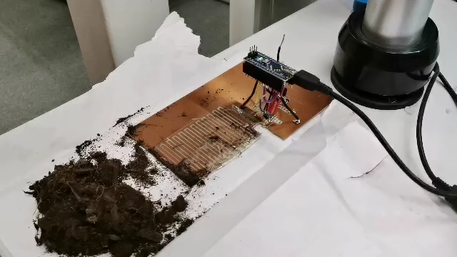
The sensor

Slide 7
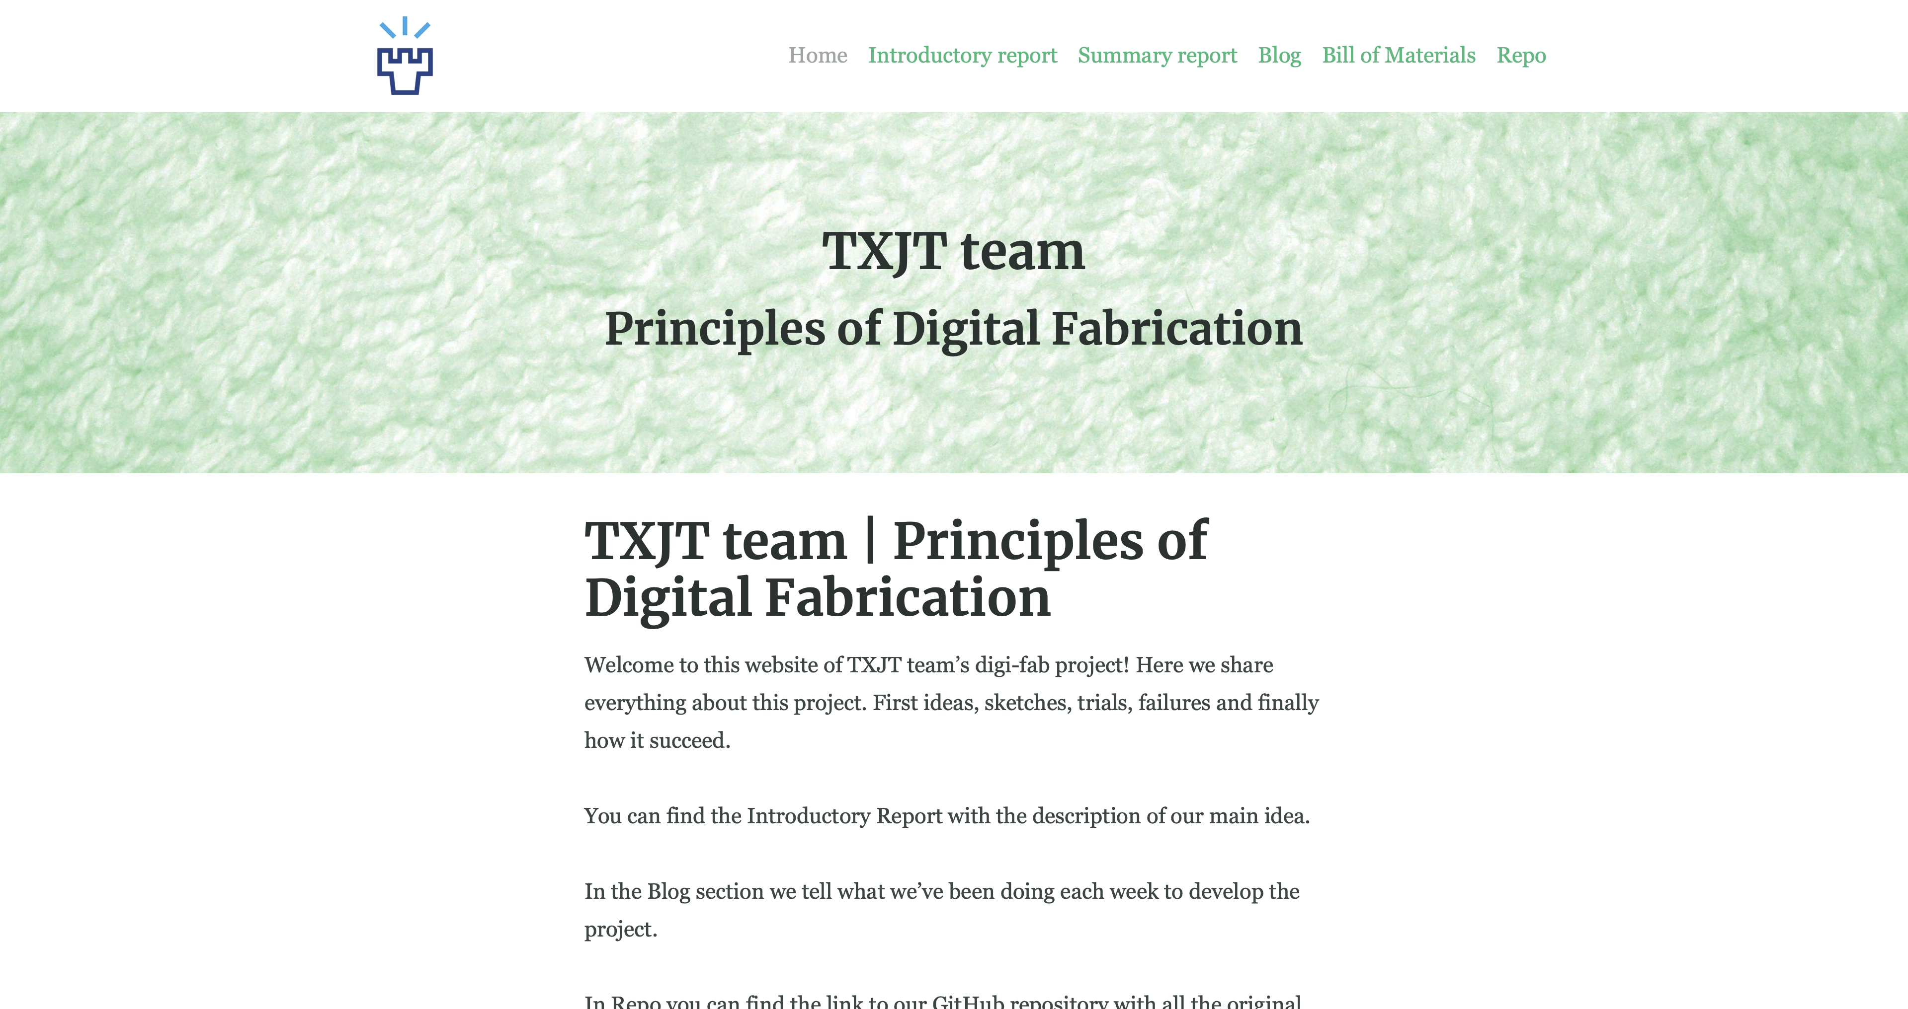
Our documentation – txjt.ml

Slide 8
What next

